Slide 1
Hospital Expansion into Toronto
Frederick R.
Date

Slide 2
Introduction
A United States hospital chain inquires if it should expand into Canada, specifically the Toronto area.
Hospital and medical facility density was analyzed to see if there was a need for additional facilities, as compared to the density pre-determined by the company. This density was based on profitable U.S. hospitals as compared to less profitable U.S. hospitals.

Slide 3
Data
Data was pulled from FourSquare’s API as well as geographic information from Geocoder/JSON and data pulls from the web.
Mapping shows that hospitals are concentrated in the downtown areas and lessen the further into the suburbs of Toronto.

Slide 4
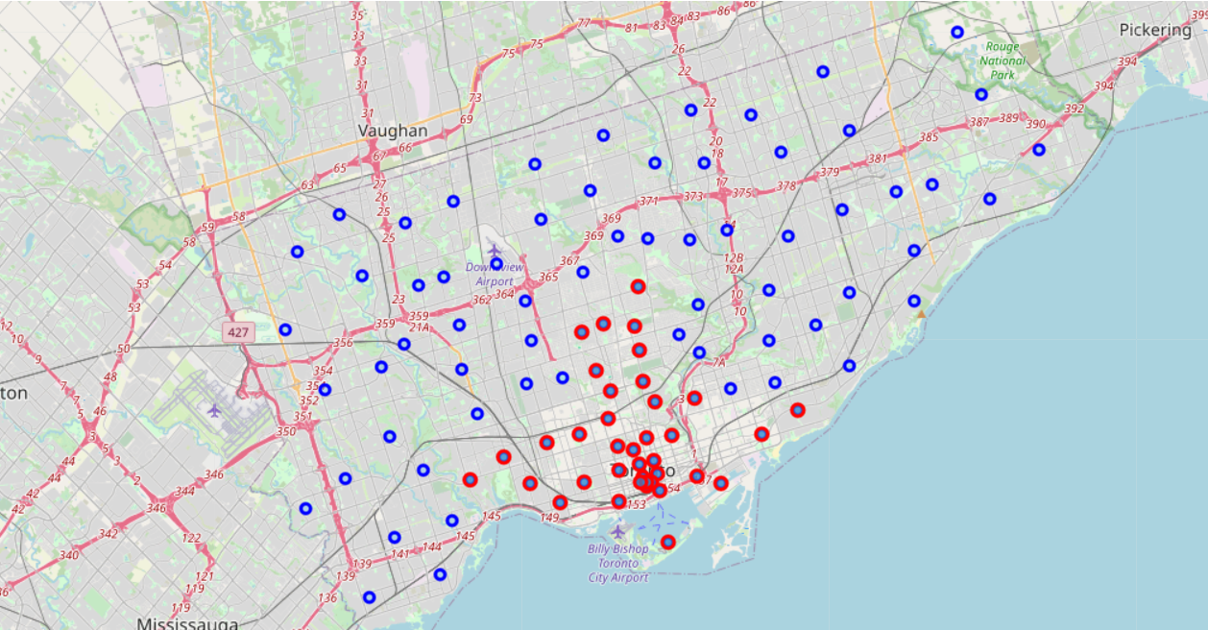
Data

Slide 5
Methodology
Data was pulled from FourSquare’s API for analysis and divided by neighborhood to see if:
(1) The expansion was warranted.
Logistic Regression
(2) Did certain neighborhoods have a higher chance of profitability than others.
K-Means

Slide 6
Results
Question 1: Overall Expansion
Question 2: K-Means Clustering
Algorithm | Jaccard | F1-score | LogLoss
Logistic Regression | 0.54 | 0.56 | 0.57
KNN | 0.67 | 0.63

Slide 7
Conclusion
Ultimately, the expansion was not recommended. The heavier populated areas are already the most saturated with hospitals and medical facilities. Should an expansion occur it should be in the suburban areas of Toronto.

